Slide 1
Water Consumption Globally
Made by James Rabideaux

Slide 2
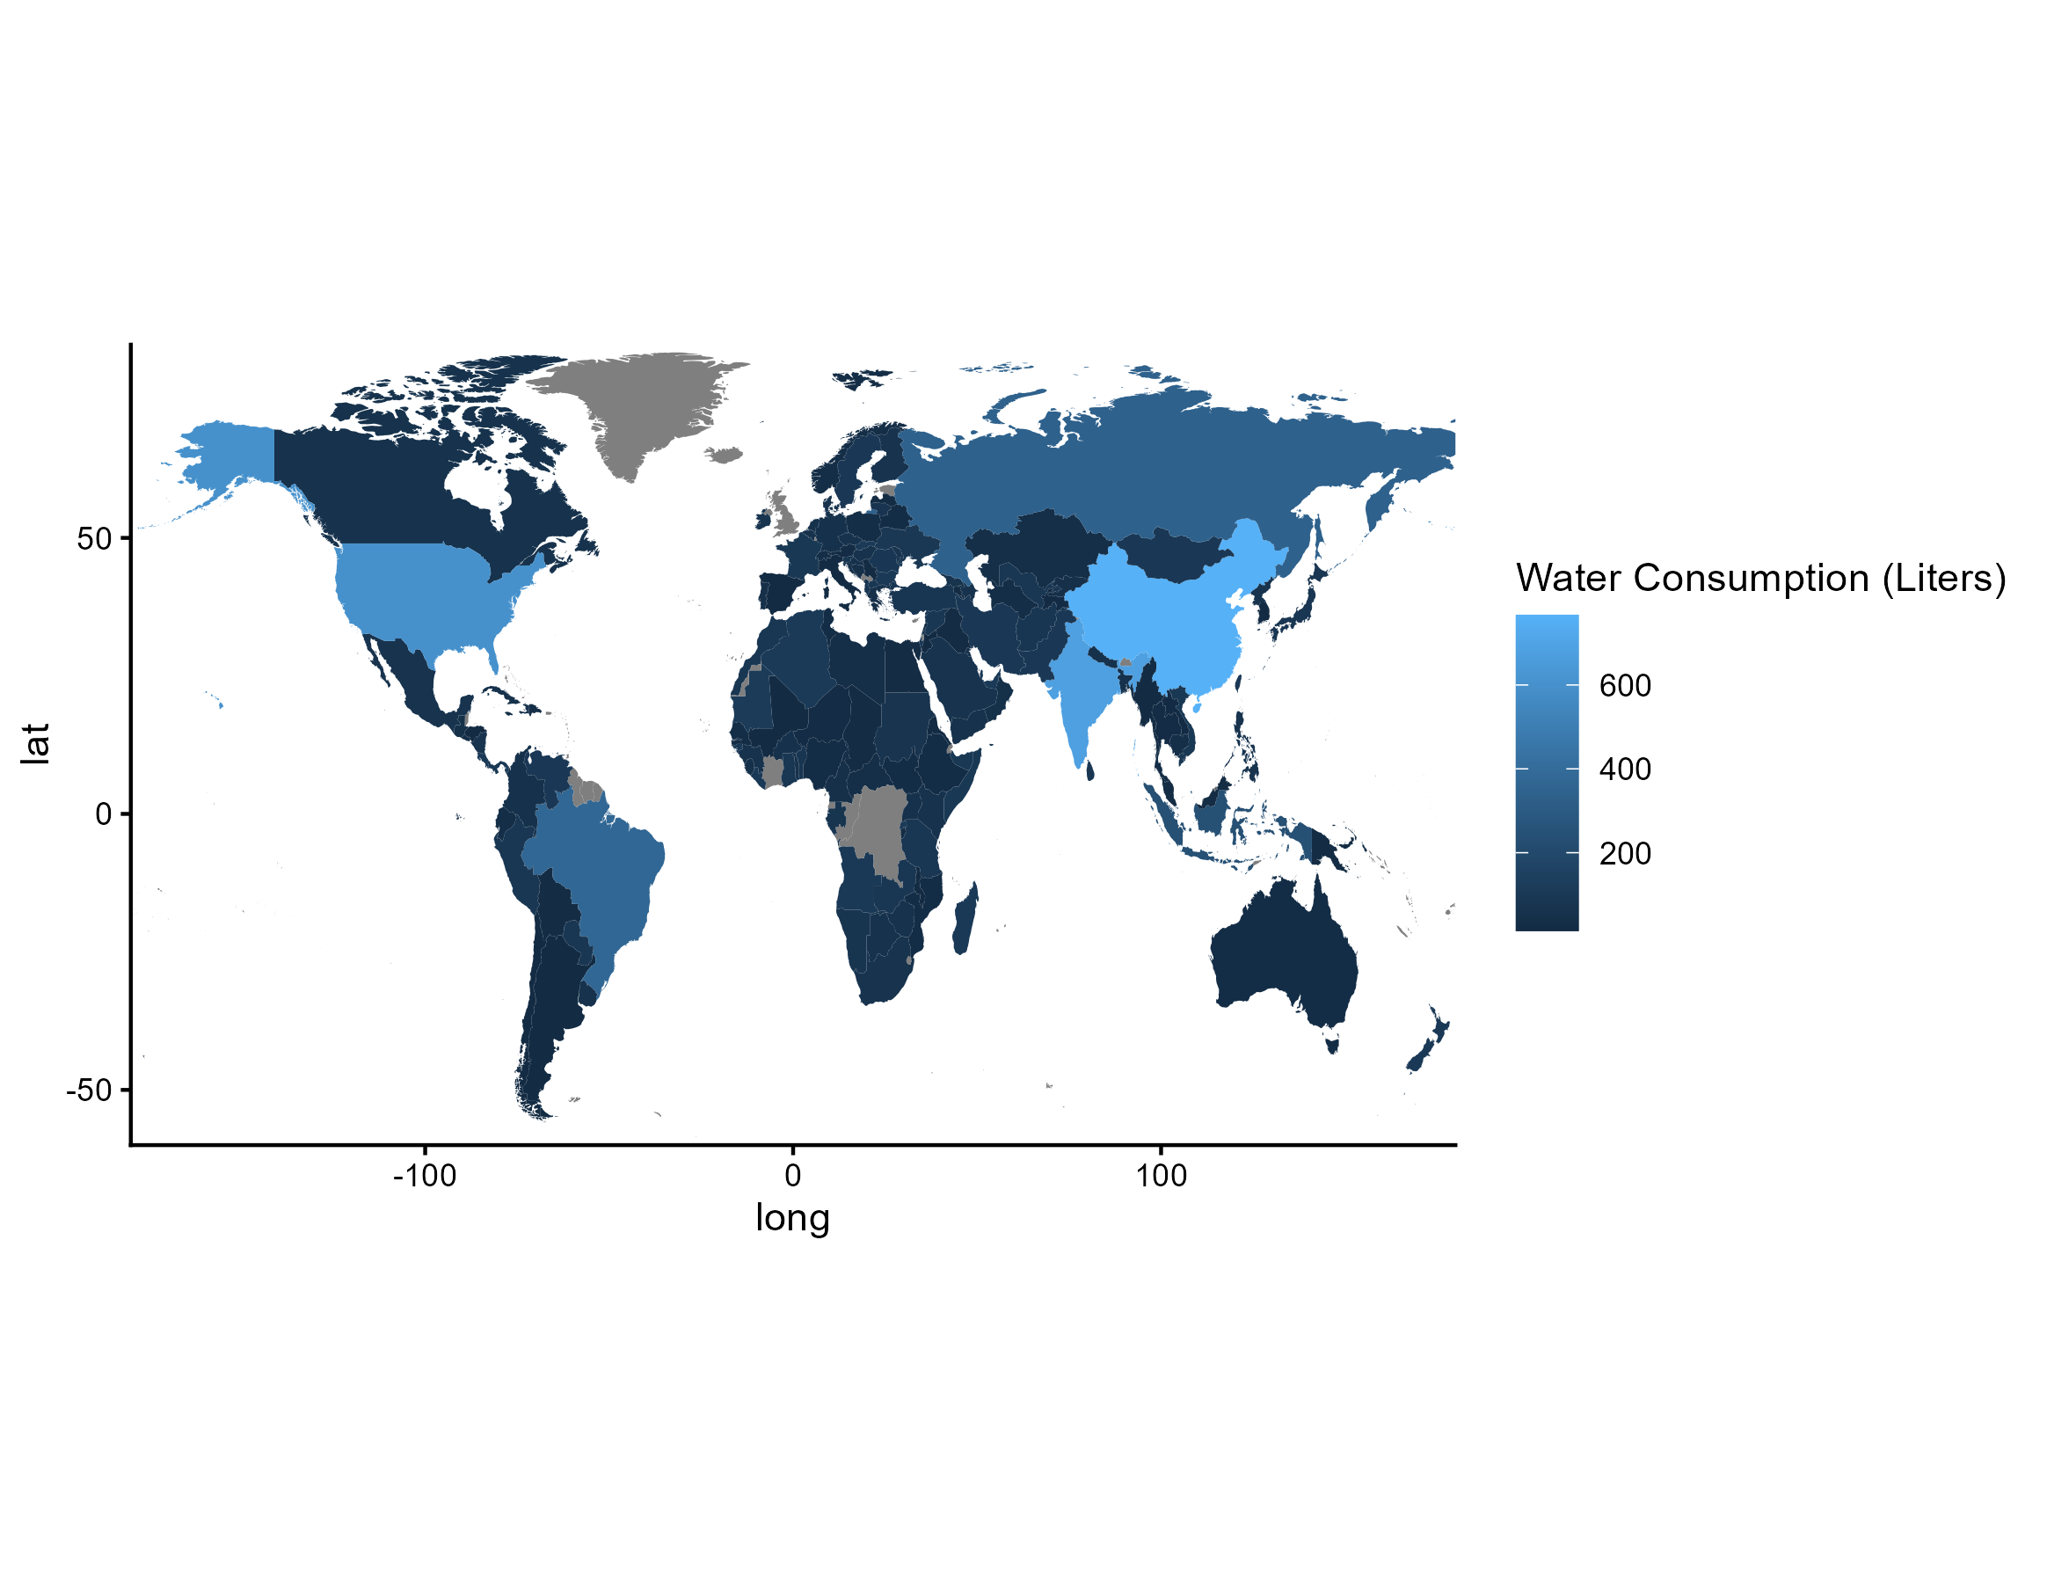
The Two Largest Consumers
At no surprise at all, the United States and China are the largest consumers when it comes to their use of water, whether is be for industrialization, the powering of coal, nuclear, and other energy sources, or even everyday household needs like toilets, washing machines, and sinks.
China’s water use has increased by 30.8% over the last 25 years, whereas the United States’ water consumption has increased 31.8%. The largest spike in recent years has been a result of AI and data centers.

Slide 3
What About the Agricultural and Industrial Sector?
China’s consumption of water in regards to agricultural use has decreased by 3.9% over the last 25 years as a result of policies passed by the Chinese government like the, “Three Red Lines”, which aimed to cap water use by 700 billion liters annually. At the same time, irrigation technology has expanded such as plastic sheeting as a means to reduce evaporation.
Industrial command has rapidly increased however; leading to a 5.6% increase in water consumption in China. The energy and manufacturing sector are the key players in this increase, primarily coal and nuclear energy.
Though water consumption isn’t capped in the United States, similar irrigation technology has led to a 6.2% decrease in the agricultural industry.
Like China, the United States has had an expansion of the industrial sector, which has led to a 3.1% increase for water from 2000-2025. The CHIPS act, passed in 2022, brought semiconductor production back into the United States; stimulating a larger demand for water.

Slide 4
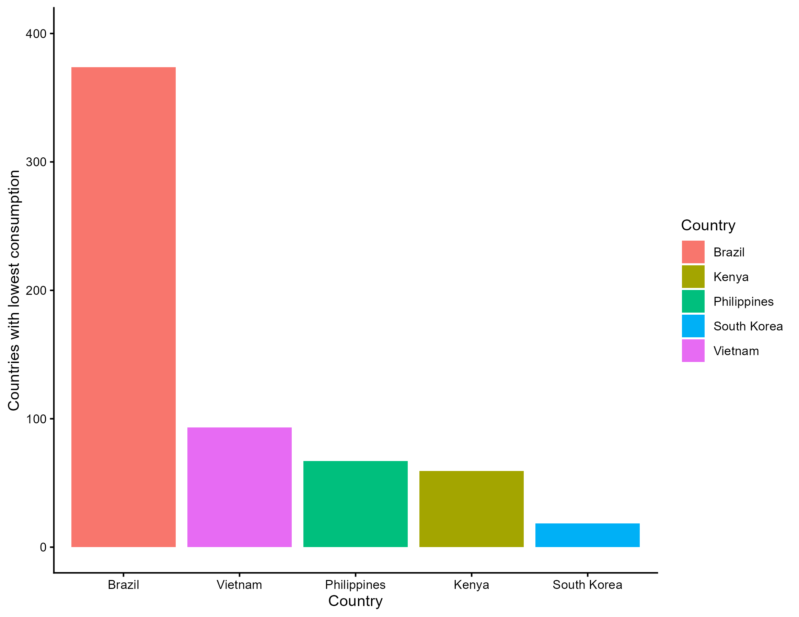
What About the Smallest Consumers of Water?
Brazil takes 5th place with 375 billion liters annually in the year 2025.
Vietnam comes in second with 98 billion liters
Third is the Philippines with 87 billion liters, with Kenya making a close second at 85 billion.
The smallest consumer of water is left to South Korea.

Slide 5
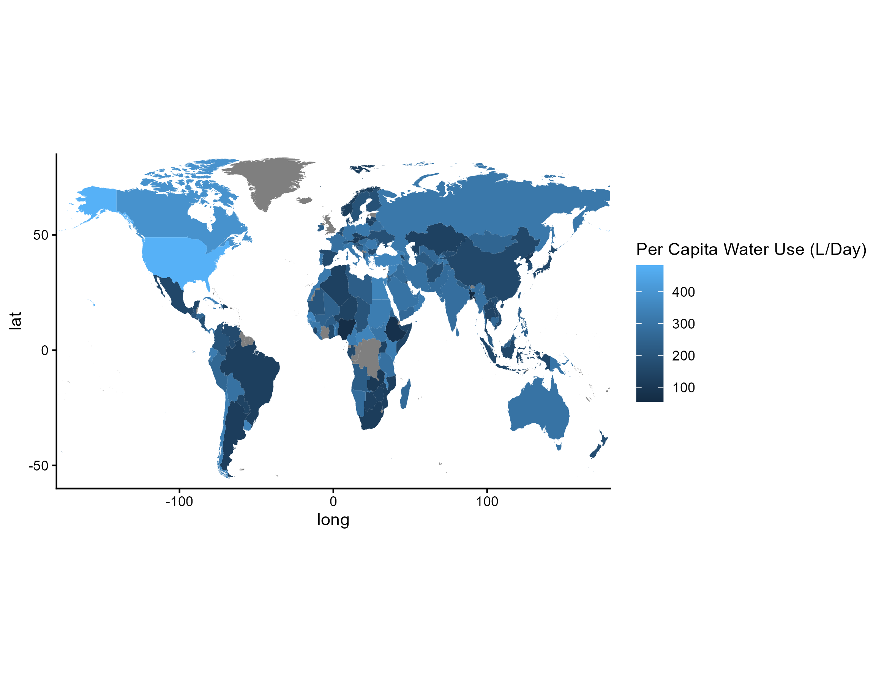
Shifting Globally, What Countries Had The Highest Consumption Rate Per Capita?
In terms of consumption per capita, the countries have changed. While the United States is still the largest consumer per capita, Canada has made an appearance as the second largest per capita.
Depending on the year that you’re viewing specifically, Syria and the Central African Republic take third place from 2000-2025.

Slide 6
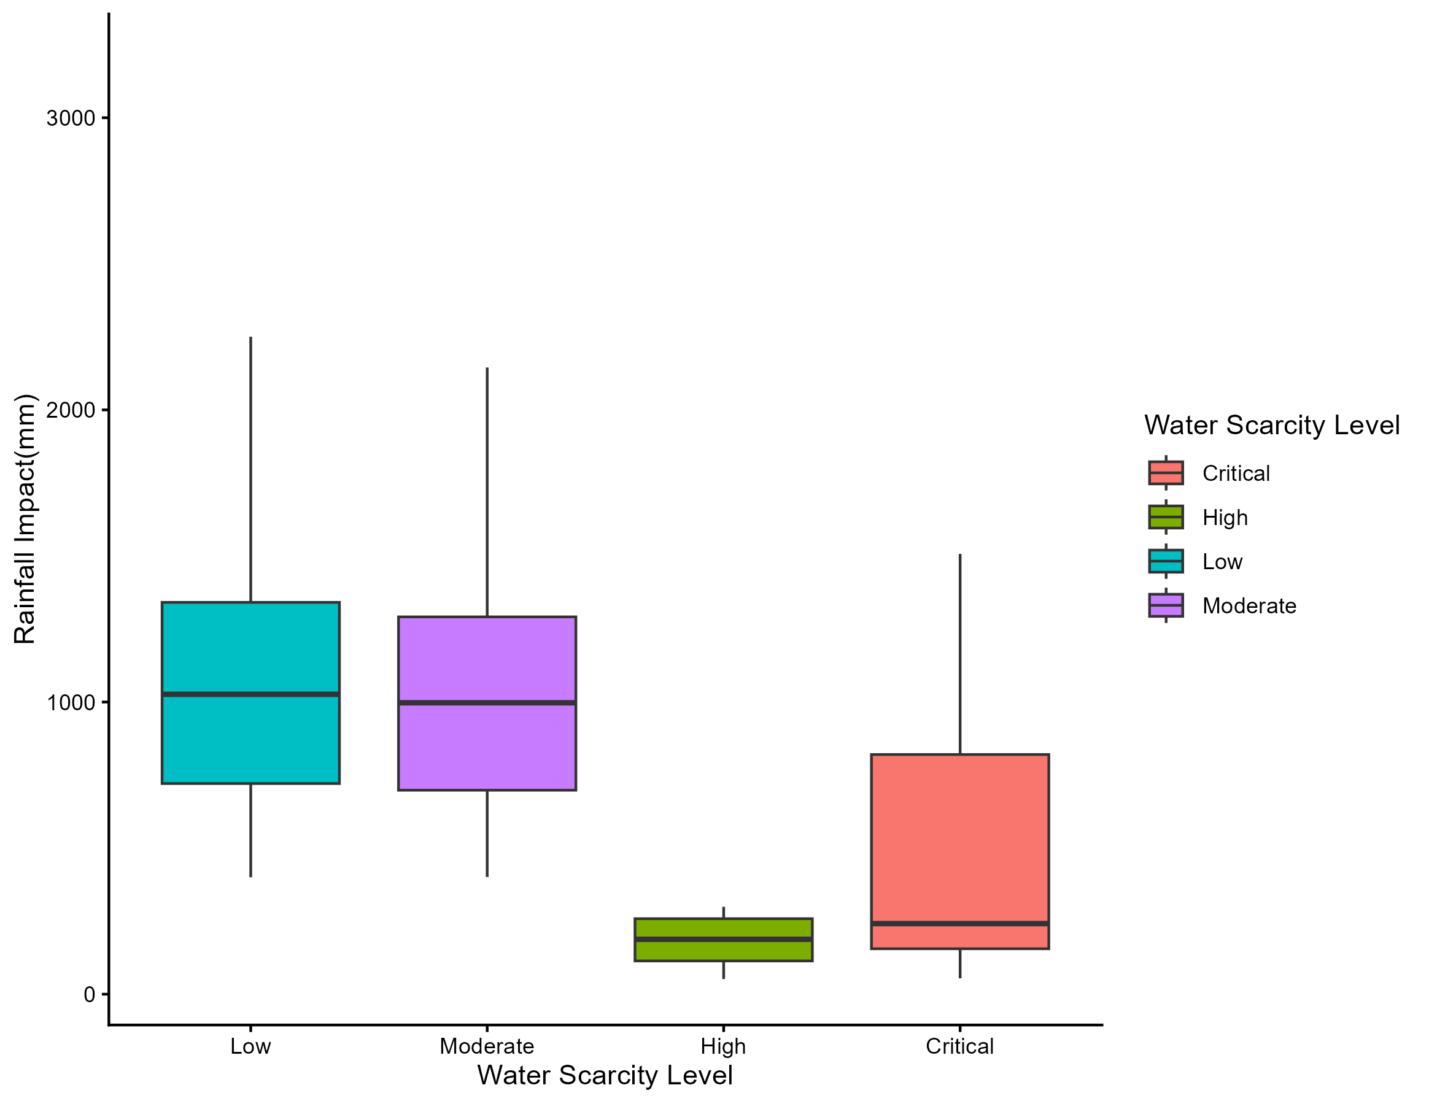
WHAT ARE THE CORRELATIONS BETWEEN RAINFALL IMPACT AND WATER SCARCITY LEVEL?
There is a clear correlation between rainfall impact and water scarcity according to the chart; showing that the higher the rainfall, the lower the water scarcity.
Countries with critical level water scarcity tend to import their water, have very poor infrastructure, and fail to store water abundantly; leading to a higher water scarcity problem than other countries, even if their rainfall is higher.

Slide 7
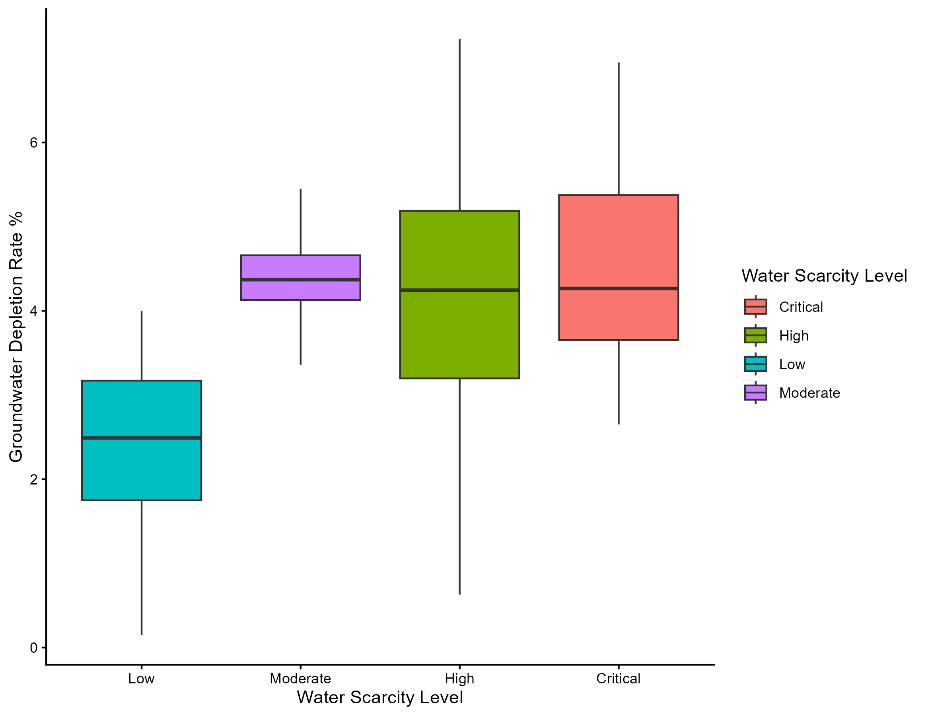
What ARE THE CORRELATIONS BETWEEN GROUND WATER DEPLETION RATE AND WATER SCARCITY?
Groundwater depletion is defined as reduction of water stored in underground aquifers; usually increasing as a direct result of rainfall.
According to the chart, there is a direct correlation between the two. The higher the ground water depletion rate, the higher the water scarcity level.

Slide 8
Thank you
I appreciate your time and guidance throughout the semester
- james rabideaux

